Slide 1
EECE 71030 – Winter 2024
Week 2 – XOR-based bit-scrambling scheme

Slide 2
Cryptography
The goal is to send secure messages over an insecure medium
Using a key alongside an algorithm turn plaintext to ciphertext
Cryptography: Creating / making secure messages
Turn plaintext to ciphertext
Cryptology: Breaking secret messages
Turn ciphertext to plaintext

Slide 3
Cryptography
Confidentiality
Prevent someone from eavesdropping or reading someone's messages
Integrity
Prevent and attacker from modifying messages without being detected
Authenticity
Prevent an attacker from impersonating someone

Slide 4
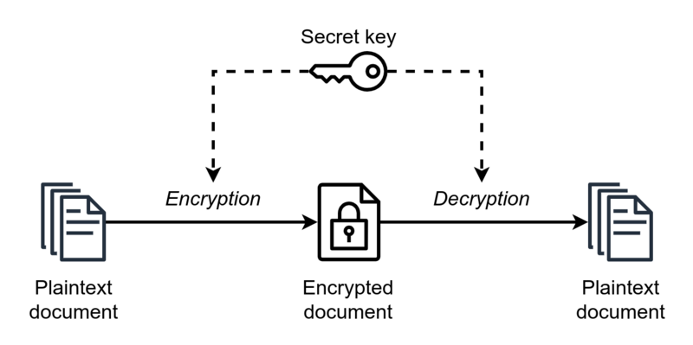
Secret-key encryption
Also known as “Symmetric Encryption”
Reference: https://upload.wikimedia.org/wikipedia/commons/thumb/6/61/Simple_symmetric_encryption.png/800px-Simple_symmetric_encryption.png

Slide 5
Secret-key encryption
“With secret-key cryptography, both communicating parties, Alice and Bob, use the same key to encrypt and decrypt the messages.” https://www.ibm.com/docs/en/sdk-java-technology/8?topic=processes-secret-key-cryptography
If Eve does not know the key, she cannot recover the plaintext.
Problem: How to share the key?
Meet in public
Share over internet
Invent new technology

Slide 6





Logic Gates
AND
OR
NAND
NOR
XOR
A | B | Q
0 | 0 | 0
0 | 1 | 0
1 | 0 | 0
1 | 1 | 1
A | B | Q
0 | 0 | 0
0 | 1 | 1
1 | 0 | 1
1 | 1 | 1
A | B | Q
0 | 0 | 1
0 | 1 | 1
1 | 0 | 1
1 | 1 | 0
A | B | Q
0 | 0 | 1
0 | 1 | 0
1 | 0 | 0
1 | 1 | 0
A | B | Q
0 | 0 | 0
0 | 1 | 1
1 | 0 | 1
1 | 1 | 0
Reference: https://en.wikipedia.org/wiki/Logic_gate

Slide 7
XOR-based bit-scrambling
An effective symmetric encryption algorithm
Easy to implement
Low resource utilization footprint
Same key to encrypt and decrypt
Uses 8-bit ASCII interpretation for input
Key has to be the same size as the message
Hard to crack via brute-forcing if truly random key used

Slide 8
XOR-based bit-scrambling
Plaintext | Key | Ciphertext | Key | Plaintext
0 | 1 | 1 | 1 | 0
1 | 0 | 1 | 0 | 1
0 | 1 | 1 | 1 | 0
0 | 1 | 1 | 1 | 0
0 | 0 | 0 | 0 | 0
0 | 1 | 1 | 1 | 0
1 | 0 | 1 | 0 | 1
0 | 0 | 0 | 0 | 0
Encrypting the letter “B” with a random key and then decrypting it.

Slide 9
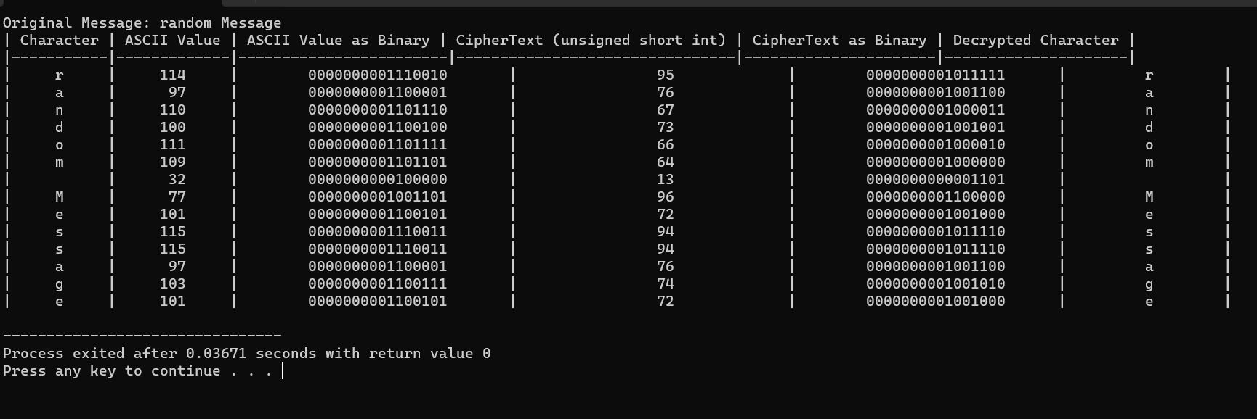
Assignment Sample Output

